Slide 1
Coordinating Conjunctions in Ancient Greek
Prof. Vanessa Gorman
University of Nebraska-Lincoln
vgorman1@unl.edu

Slide 2
Conjunctions
Coordinating
Words that join words, phrases, or clauses of equal value
“And,” “or,” “but,” “yet,” “either… or,” “neither… nor,” etc.
Subordinating
Words that introduce clauses that are dependent upon the main/independent clause
Since, that, after, before, if, as, when, etc.
Note: subordinating conjunctions do not include “who” or “what,” because these relative pronouns/adjectives introduce a peculiar kind of subordinate clause, called a relative clause. We will deal with them separately.

Slide 3
Coordinating Conjunctions in Greek
καί or τε [enclitic] or τε καί, etc. (“and”)
τε ... καί or τε … τε ... τε, or καί … καί, or virtually any combination
ἀλλά (“and” usually used to join parallel clauses or sentences)
δέ (“and” usually used to join parallel clauses or sentences)
μέν ... δέ (implies a contrast: “on the one hand…on the other…”
οἱ μὲν …, οἱ δέ… (“Some people…. other people…”)
οὐδέ (“and not” or “not even”); οὐδέ … οὐδέ… (“neither … nor…”)
οὔτε ... οὔτε ... (“neither … nor…”)

Slide 4
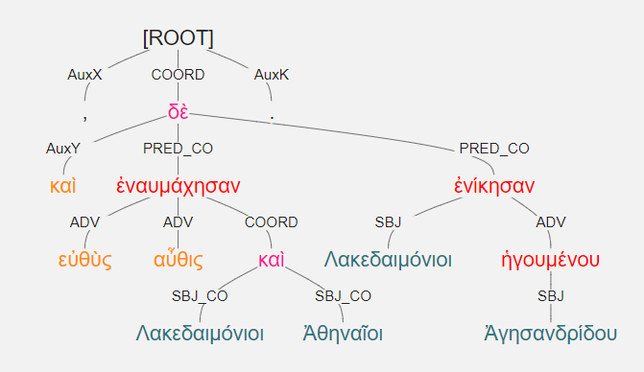
Things to note
In trees, the solo or final coordinator is labelled:
Part of Speech = Conjunction
Relation = “COORD”

Slide 5
Things to note
In trees, the solo or final coordinator is labelled:
Part of Speech = Conjunction
Relation = “COORD”
The elements being coordinated are labeled with the suffix “CO”

Slide 6
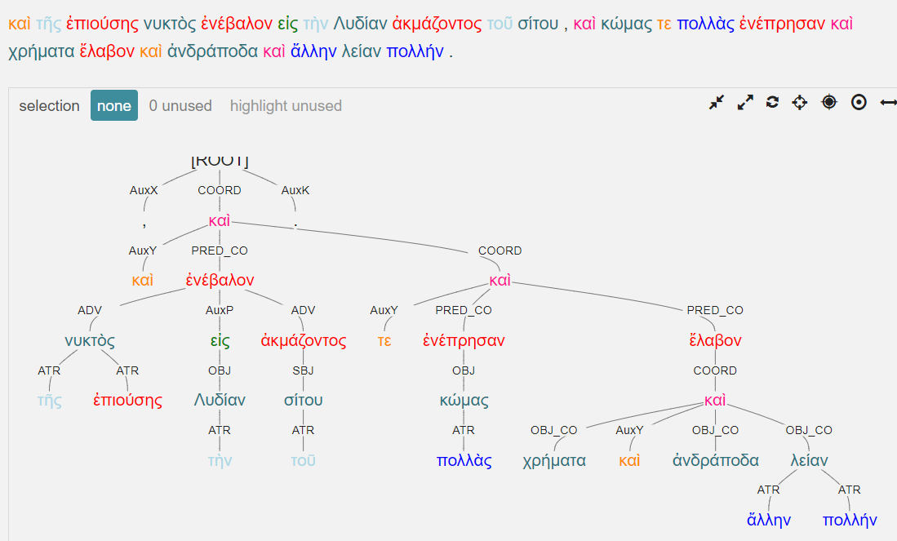
Things to note
Coordination may be nested

Slide 7
Things to note
In trees, earlier coordinators in a series hang on the final coordinator and are labelled:
Postag = ADV
Relation = AuxY

Slide 8
Things to note
In trees, earlier coordinators in a series hang on the final coordinator and are labelled:
Postag = ADV
Relation = AuxY

Slide 9
Things to note
Coordinators are used between parallel relation elements
Two substantives, two ATR, two ADVs, two PREDs, etc.
You cannot coordinate an ADV and a PRED, for example.
`

Slide 10
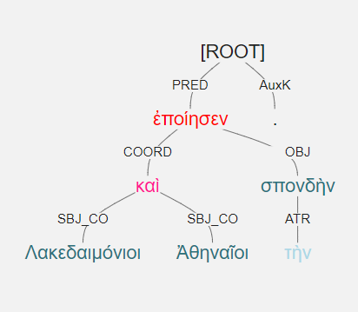
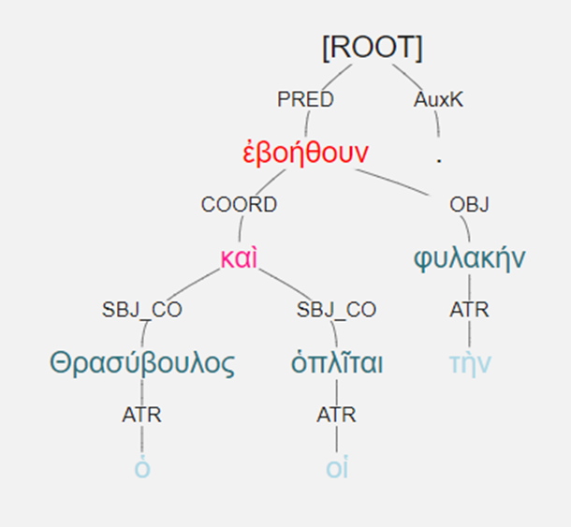
Λακεδαιμόνιοι καὶ Ἀθηναῖοι τὴν σπονδὴν ἐποίησεν. ὁ Θρασύβουλος καὶ οἱ ὁπλῖται ἐβοήθουν τὴv φυλακήν.

Slide 11
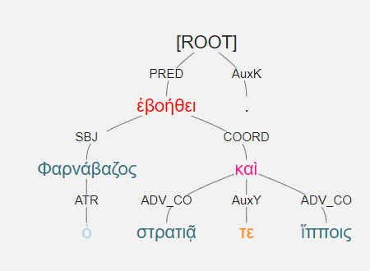
ὁ Φαρνάβαζος ἐβοήθει στρατιᾷ τε καὶ ἵπποις.

Slide 12
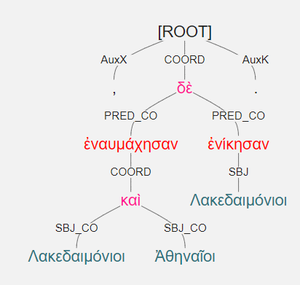
ἐναυμάχησαν Λακεδαιμόνιοι καὶ Ἀθηναῖοι, ἐνίκησαν δὲ Λακεδαιμόνιοι.

Slide 13
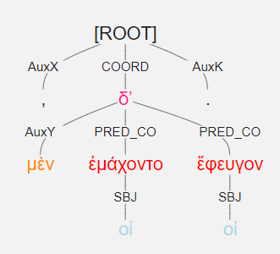
οἱ μὲν ἐμάχοντο, οἱ δʼ ἔφευγον.

Slide 14
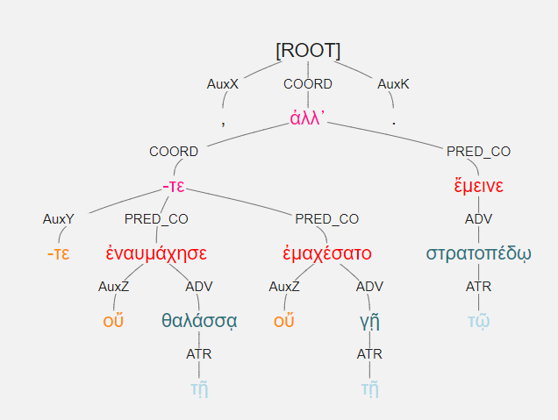
οὔτε ἐναυμάχησε τῇ θαλάσσᾳ οὔτε ἐμαχέσατο τῇ γῇ, ἀλλ᾽ ἔμεινε τῷ στρατοπέδῳ.

